Slide 1
Introduction to Data Analytics
Data Analytics is the analysis of large databases to find novel and valuable patterns
Data Mining – It is the process of building models to extract meaningful information from raw data
A model is useful in the following ways:
Can be used to make predictions
Can help in understanding
Captures the essence of the knowledge discovered

Slide 2
Application areas
Business
Government
Finance sector
Biological sciences
Medicine
Human Resources
Markets
……..

Slide 3
Data Explosion
Most data goes straight to computers
Data may or may not be created by human beings

Slide 4
What to do?
Understand the context and frame a question
Translate the business question into a data analytics question
Collect, understand and process data
Build models and evaluate
Deploy the results
The process should be Iterative and Incremental ???

Slide 5
Some terms
Ground truth = the real thing
Gold standard = the best we can get
Bronze standard = gold standard with limitations
Reference standard = preferred term for gold standard in the medical community

Slide 6
What to evaluate?
Without reference standard, subjective or qualitative evaluation is hard to avoid
Region/pixel based comparisons
Border/surface comparisons
(a selection of) Points
Global performance measures versus local measures

Slide 7
Why Evaluate?
Multiple methods are available to classify or predict
For each method, multiple choices are available for settings
To choose best model, need to assess each model’s performance

Slide 8
Misclassification error
Error = classifying a record as belonging to one class when it belongs to another class.
Error rate = percent of misclassified records out of the total records in the validation data

Slide 9

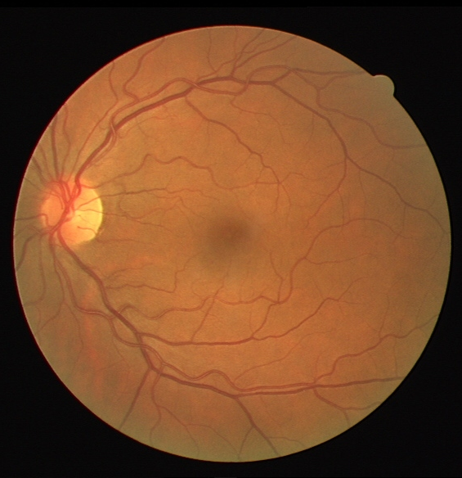
What region to evaluate over?

Slide 10
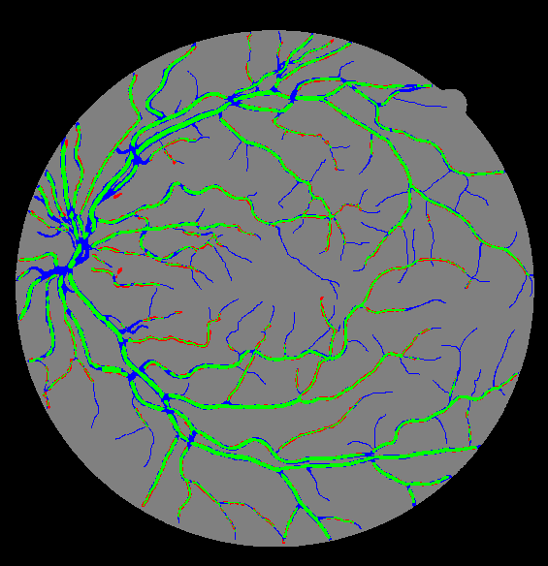
Combination of reference and result
masked
true positive
true negative
false negative
false positive
Notes:
Ask to estimate percentage of FP

Slide 11
Confusion Matrix
A confusion matrix (Kohavi and Provost, 1998) contains information about actual and predicted classifications done by a classification system. Performance of such systems is commonly evaluated using the data in the matrix.

Slide 12
The following table shows the confusion matrix for a two class classifier. The entries in the confusion matrix have the following meaning in the context of our study:
● a is the number of correct predictions that an instance is negative,
● b is the number of incorrect predictions that an instance is positive,
● c is the number of incorrect of predictions that an instance negative, and
● d is the number of correct predictions that an instance is positive.

Slide 13
Confusion matrix
Calculate four quantities:
True Positives (TP): answer = YES, model said YES
True Negatives (TN): answer = NO, model said NO
False Positives (FP): answer = NO, model said YES
False Negatives (FN): answer = YES, model said NO

Slide 14
Do not get confused!
False positives are actually negative
False negatives are actually positives

Slide 15
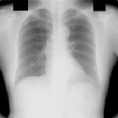
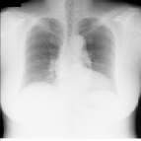
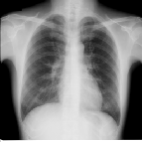
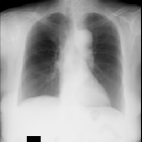
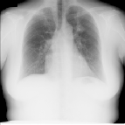
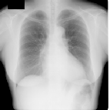
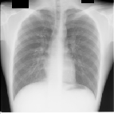
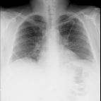
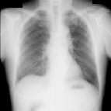
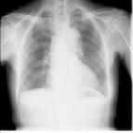
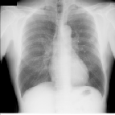
P
N
N
P
P
P
N
N
P
N
N
P
P
true positives (TP)
P
false positives (FP)
sensitivity = TP / (TP + FN)
N
false negatives (FN)
N
true negatives (TN)
specificity = TN / (TN + FP)
accuracy = (TP+TN) / (TP+TN+FP+FN)
Notes:
in a way, sensitivity and specificity are more interesting measures than accuracy, because they do not depend on the prior distribution of negatives and positives in the test database. the sensitivity is computed from only positive cases, and is the detection rate of the algorithm, the specificity is computed from only negative cases, and is one minus the chance of false alarm.

Slide 16
P
N
N
P
P
P
N
N
P
N
N
P
P
true positives (TP) = 3
sensitivity = TP / (TP + FN)
= 3 / 5 = 0.6
P
false positives (FP) = 3
N
false negatives (FN) = 2
N
true negatives (TN) = 4
specificity = TN / (TN + FP) = 4 / 7 = 0.57
accuracy = (TP+TN) /
(TP+TN+FP+FN) = 7 / 12 = 0.58
Notes:
in a way, sensitivity and specificity are more interesting measures than accuracy, because they do not depend on the prior distribution of negatives and positives in the test database. the sensitivity is computed from only positive cases, and is the detection rate of the algorithm, the specificity is computed from only negative cases, and is one minus the chance of false alarm.

Slide 17
P
P
P
P
P
P
P
N
N
P
P
P
N
N
P
P
N
P
N
N
P
N
N
P
P
= 3
N
= 2
sensitivity = 3 / 5 = 0.6
algorithm 1
specificity = 4 / 7 = 0.57
P
= 3
N
= 4
accuracy = 7 / 12 = 0.58
P
= 4
N
= 1
sensitivity = 4 / 5 = 0.8
algorithm 2
specificity = 2 / 7 = 0.29
P
= 5
N
= 2
accuracy = 6 / 12 = 0.5
Which system is better?
Notes:
So you see there is a trade-off, you can go for high sensitivity, and sacrifice specificity, and have a system with a high detection rate that does not miss many abnormalities. The other way around, you can decide to

Slide 18
Overlap = intersection / union = TP/(TP+FP+FN)
Reference
Segmentation
TP
FN
FP
TN

Slide 19
Overlap
Overlap ranges from 0 (no overlap) to 1 (complete overlap)
The background (TN) is disregarded in the overlap measure
Small objects with irregular borders have lower overlap values than big compact objects

Slide 20
Centrality Indices

Slide 21
Introductory Examples
Election of a leader is a frequent event in many social groups and intuitively, some persons in such an event are more important or ‘central’ than others, e.g. the candidates.
Centrality can be interpreted as - among other things - ‘influence’, as ‘prestige’ or as ‘control’.
we could view the general social network of the class: Who is friends with whom? Someone who is a friend of an important person could be regarded as more important than someone having friends with low social prestige.

Slide 22
Degree Centrality
The most simple centrality is the degree centrality cD (v) of a vertex v that is simply defined as the degree d(v) of v if the considered graph is undirected.
In directed networks two variants of the degree centrality may be appropriate:
the in-degree centrality ciD (v) = d⁻(v) and
the out-degree centrality coD (v) = d⁺(v).

Slide 23
Facility Location Problem
Facility location analysis deals with the problem of finding optimal locations for one or more facilities in a given environment. Location problems are classical optimization problems with many applications in industry and economy.
The spatial location of facilities often take place in the context of a given transportation, communication, or transmission system, which may be represented as a network for analytic purposes.

Slide 24
There exist several ways to classify location problems. According to Hakami who considered two families of location problems we categorize them with respect to their objective function.
The first family consists of those problems that use a minimax criterion. As an example, consider the problem of determining the location for an emergency facility such as a hospital. The main objective of such an emergency facility location problem is to find a site that minimizes the maximum response time between the facility and the site of a possible emergency.
The second family of location problems considered by Hakimi optimizes a minisum criterion which is used in determining the location for a service facility like a shopping mall. The aim here is to minimize the total travel time.
A third family of location problems described for example in deals with the location of commercial facilities which operate in a competitive environment. The goal of a competitive location problem is to estimate the market share captured by each competing facility in order to optimize its location.

Slide 27
The term “diameter” is defined as the maximum eccentricity and also as the path of length equal to the maximum eccentricity.
The radius of a graph is the minimum eccentricity among all vertices in the graph, and a center of a graph is a vertex with eccentricity equal to the radius.
For a general graph, there may be several centers and a center is not necessarily on a diameter.

Slide 29
Closeness Centrality

Slide 30
Centroid values
The centrality index presented here is used in competitive settings:
Suppose each vertex represents a customer in a graph.
The service location problem considered above assumes a single store in a region. In reality, however, this is usually not the case. There is often at least one competitor offering the same products or services. Competitive location problems deal with the planning of commercial facilities which operate in such a competitive environment.
For reasons of simplicity, we assume that the competing facilities are equally attractive and that customers prefer the facility closest to them.
Consider now the following situation:
A salesman selects a location for his store knowing that a competitor can observe the selection process and decide afterwards which location to select for their shop. Which vertex should the salesman choose?

Slide 32
Shortest Paths
We will call a vertex v or an edge e, (graph) ’element’ and denote the centrality of an element in general by x. The first two indices, stress and betweenness centrality of an element x, are based on the (relative) number of shortest paths that contain x.

Slide 33
The first centrality index based on enumeration of shortest paths is stress centrality C_{S} (x).
It was concerned with the following question: how much ‘work’ is done by each vertex in a communication network.
It is clear that communication or transport of goods will follow different kinds of paths in a social network. Nonetheless, the author models the set of paths used for communication as the set of shortest paths. The assumption is that counting the number of shortest path that contain an element x gives an approximation of the amount of ‘work’ or ‘stress’ the element has to sustain in the network.
With this, an element is the more central the more shortest paths run through it. The formal definition is given as follows, where σ_{st} (v) denotes the number of shortest paths containing v:

Slide 34
Although this centrality was designed to measure stress on vertices, the same definition can be applied for edges, where σst (e) denotes the number of shortest paths containing the edge e:

Slide 35
Betweenness Centrality
Betweenness centrality quantifies the number of times a node acts as a bridge along the shortest path between two other nodes.
It was introduced as a measure for quantifying the control of a human on the communication between other humans in a social network by Linton Freeman.
In this conception, vertices that have a high probability to occur on a randomly chosen shortest path between two randomly chosen vertices have a high betweenness.

Slide 36
The betweenness of a vertex v in a graph G := (V, E) with V vertices is computed as follows:
For each pair of vertices (s, t), compute the shortest paths between them.
For each pair of vertices (s, t), determine the fraction of shortest paths that pass through the vertex in question (here, vertex v).
Sum this fraction over all pairs of vertices (s, t).
where σst is total number of shortest paths from node s to node t and σst(v) is the number of those paths that pass through v.

